Slide 1
Passing a Method to a Method (big concept) and Delegates (simple concept)
https://csharp-station.com/Tutorial/CSharp/Lesson14

Slide 2
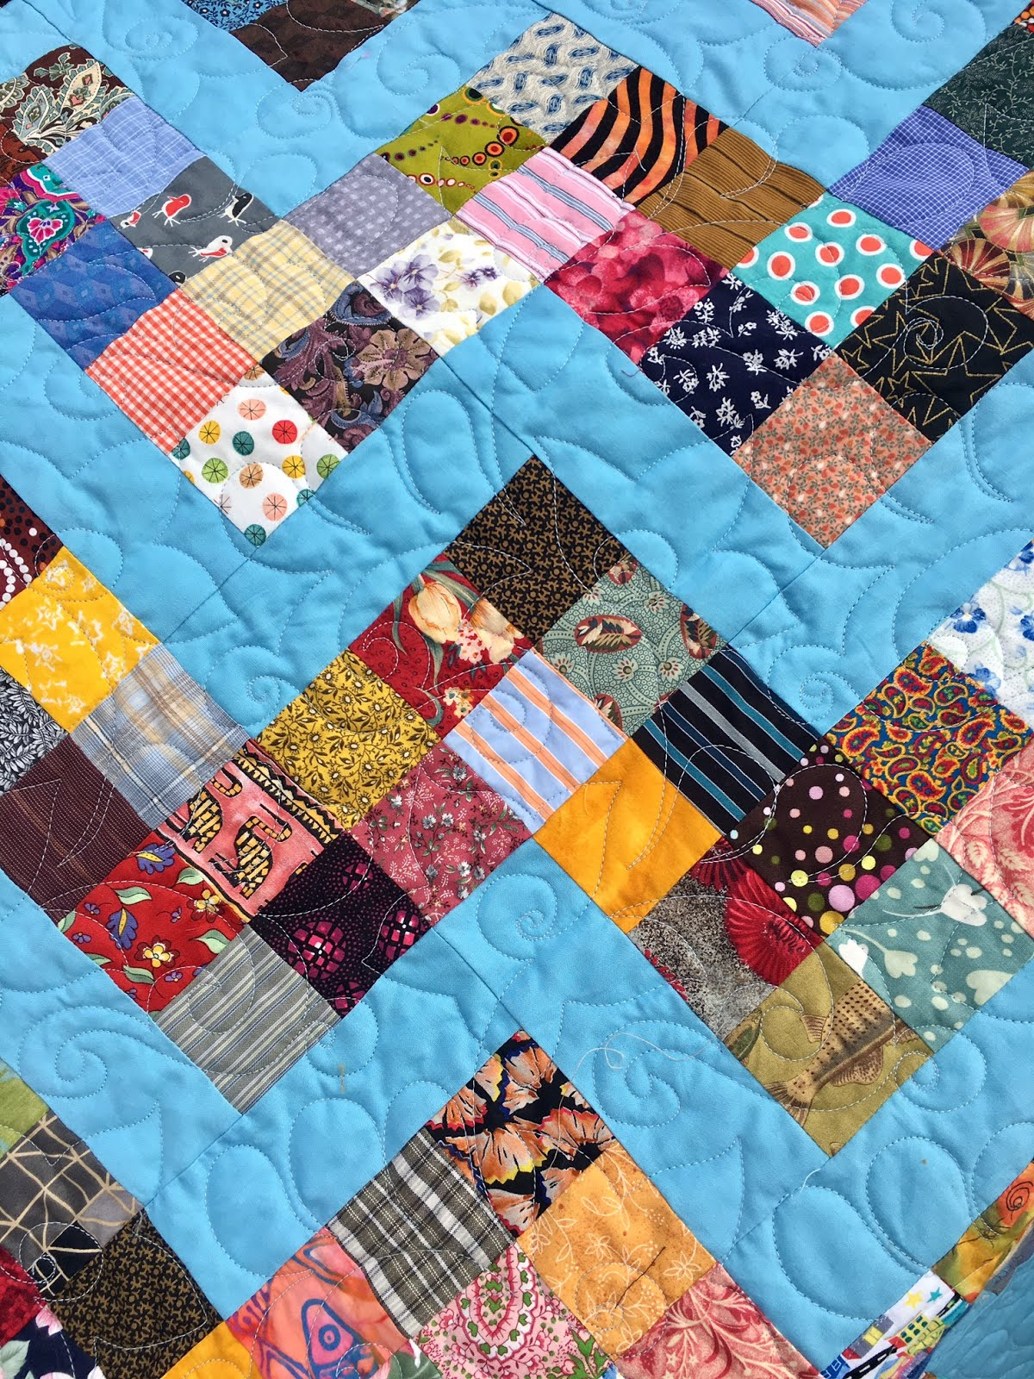
Quilts

Slide 3
delegates
In many cases it makes sense to pass in the name of a method to another method so that 2nd method can use the code passed into it
To allow a method signature to specify it wants a method as a parameter, we have to give that method thing a “type”.
Just like we used the word “enum” to define a new data type (Rank) we use the work “delegate” to define a new data type that IS a method
This new data type is a contract between the method that wants a method and the method being passed into it, saying what the signature of the method must be.

Slide 4
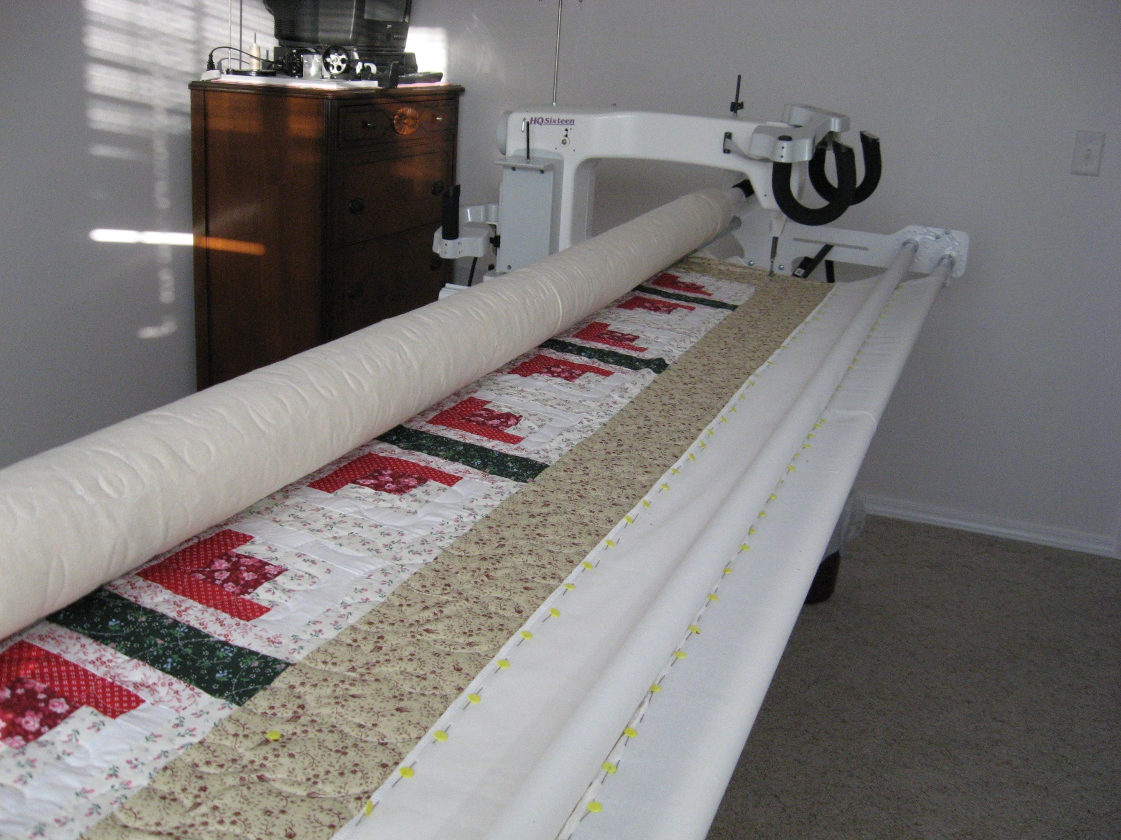
Real life “similar” examples
Quilting store has a machine that quilts a pattern.

Slide 5


The “object”, the machine, has the code (a method) to do quilting. You pass in a new “method”, a USB stick, with a pattern you like.

Slide 6
Passing methods:
User Program
Public void MakePrettyStar( )
{
Your special code to draw a star
}
Start the machine by calling
MyQuilt.QuiltThisWay(MakePrettyStar);
MyQuilt Object
QuiltThisWay(give me a method)
{
quilt code …
MakePrettyStar()
quilt code …
}

Slide 7
That is the big idea
You can write a method, and then give that method to another method and have it run your method. (JavaScript calls this a “callback”)
When you pass in a pass-in-method as a parameter to a use-your-method, as you call the use-your-method, you can set the parameter ( ) to be either:
The actual name of your pass-in-method,
Or, you can give your pass-in-method a name.
If you give a name to your pass-in-method, then that name is “of data type Delegate Method”. A Delegate method is a data type variable that is allowed to point to a method.

Slide 8
give your pass-in-method a name
If you look at a C# program, and see a variable called myVariable, what could that variable be:
An int
A string
A new data type you defined using enum
An object (from a Class or a Struct)
Could it be a name for a method?? yes

Slide 9
Yes!
Delegates allow you to create a variable that is a method call.
Say you had two methods
DrawHandsBW(computerHand, myHand);
DrawHandsColor(computerHand, myHand);
You could have a variable that was equated to the DrawHandsBW method, lets use MyMethodVar
Then, after assigning that variable, MyMethodVar, a value (MyMethodVar = DrawHandsBW)
You could write:
MyMethodVar(computerHand, myHand);
Then you could re-assign MyMethodVar to refer to another method, (MyMethodVar = DrawHandsColor)
, and then get a different result from
MyMethodVar(computerHand, myHand);

Slide 10
What did we do?
We created a variable, and instead of it pointing to an int
int foo; // foo can now hold some integer
Or pointing to a string
string foo; // foo can now hold some string
We assigned it to point to method.
DelegateDefintionX foo; // foo can now point to some method you wrote.
However, this idea of giving a method a name is a smaller part of the big idea. The big idea is passing in a method1 (some code) to another method2 so that method2 can do something specific (method1) that you tell it to.
Delegate variables just makes it easier to do that.

Slide 11
But why pass a method to a method?
This lets you write a Class that is more general, so
You can write lots of common code, that applies to all situations, but using that same general method, give it “special directions” to handle one aspect of the general method uniquely
Remember the quilt machine, lots of instructions to move the machinery back and forth across the machine, this is done for all quilts, but to tell it what pattern to use for this particular call to the quilt method, we pass in the name of a method that knows how to make the special pattern we want for this call.
For Async “call backs”, you ask code that will take a while to do something, and you tell it, “when you finish the job, please do this”. That way your main line of code is not blocked. (events, more on this later)
Also widely used for a general method that operates on different data types, so the user calls the method and then passes in the code that can process THAT data type (Sort could have used this mechanism instead of the IComparable)

Slide 12
Look at program
1-PassMethodNoDelegate

Slide 13
But it’s a bit more complicated
When a method wants to take in a method, it needs to define a new data type for that parameter. You use the key word delegate to define this new variable type.
First your define a new type of delegate, giving it your own name (e.g. TriMethods) and then when you want to define a delegate method name, you use that “type”. See next slide.

Slide 14
Delegate: a new data type, which is a specification of a method signature
public delegate void QuiltPattern(int width);
Delegate variable: just a variable of “type” your-delegate, with any name you like. QuiltPattern myPattern;
Your “here’s the code I want you to execute”, which is a normal method definition, with any name you like, but whose signature must match the Delegate definition. (you can have more than one method defined that meet the spec.)
public void StarPattern(int width)
{ code }
Assign a value to your Delegate variable , similar to
string myName;
myName = “Kurt”;
QuiltPattern myPattern;
myPattern = StarPattern; //new name for your method

Slide 15
That was one half of the story;
The normal use is, you use that Delegate variable myPattern (which is a pointer to some real method you wrote)
And you pass that in as an parameter to some other method. This other method will then, at some point in its code path, call your method
ExecuteQuiltPattern(“red", 34, myPattern);
Then the code in the ExecuteQuiltPattern …
public void ExecuteQuiltPattern(string color, int size, QuiltPattern passedInMethod)
{
code …
passedInMethod(size); //call back to your defined method
code …
}

Slide 16
You create a new data type using the delegate key word
public delegate void ProvideGreeting(string name);
That delegate definition is a contract published by the method that WANTS a method passed it, specifying what the signature of the method must be as you pass one in to it.

Slide 17
Using a Delegate: quite a few steps
Define a Delegate, specifying a signature that a compliant method must adhere to; the format required by the quilt machine method WriteGreetingsMethod(give me a method)
public delegate void ProvideGreeting(string name);
Implement one or more methods that match the specified signature to fulfill the type definition
public static void GoodMorning(string name) { … }
public static void GoodAfternoon(string name) { … }
public static void GoodNight(string name) { … }
Then define a “delegate variable” of type “your Delegate”
ProvideGreeting myGreetMethod;
Then assign one of the compatible methods to your variable
myGreetMethod = GoodAfternoon;
Call the method: WriteGreetingsMethod(myGreetMethod)
Same thing: WriteGreetingsMethod(GoodAfternoon)

Slide 18
One more time!

Slide 19
Contract between class that wants to use it and defining method
public delegate int Comparer(object obj1, object obj2); //delegate declaration
class Program
static void Main(string[] args)
{
NameBank ourNames = new NameBank(); //object instantiation
Comparer cmp1 = CompareFirstNames; //delegate instantiation
…
ourNames.Sort(cmp1);
…
}
//delegate method that satisfies definition, does what you want it to
public static int CompareFirstNames(Name name1, Name name2)
{
code; // your special code your want to pass into some other object
}
class NameBank //class can be used in lots of other classes
…
//class provides a Sort method, but requires you to tell it how to sort
public void Sort(Comparer compare) //requires you to pass in a method
{
…
if (compare(names[i], names[j]) > 0)
…
}

Slide 20
Contract between class that wants to use it and defining method
public delegate int Comparer(object obj1, object obj2); //delegate declaration
class Program
static void Main(string[] args)
{
NameBank ourNames = new NameBank(); //object instantiation
Comparer cmp1 = CompareFirstNames; //delegate instantiation
…
ourNames.Sort(cmp1);
…
}
//delegate method that satisfies definition, does what you want it to
public static int CompareFirstNames(Name name1, Name name2)
{
code; // your special code your want to pass into some other object
}
class NameBank //class can be used in lots of other classes
…
//class provides a Sort method, but requires you to tell it how to sort
public void Sort(Comparer compare) //requires you to pass in a method
{
…
if (compare(names[i], names[j]) > 0)
…
}

Slide 21
If you had this method defined:
private static void CheckNameLength(string passedInName)
{
wonderfull code;
}
string firstName = "Bob";
You can call it either way:
CheckNameLength(firstName);
CheckNameLength("Bob");

Slide 22
Delegate variable
You don’t need to create a delegate variable …
If you have a delegate definition
You have a method the matches that definition
You have some other class that has a method defined that takes in a parameter of that delegate definition,
Then
You can just pass the name of your method in directly to the other class’s method, without first making up a delegate variable to hold a pointer to your method.

Slide 23
Look at programs
2-DelegatesAnotherExample
3-DelegatesPersonFilter

Slide 24
Slides for Part 2

Slide 25
Multi-cast Delegates
A delegate instance can refer to multiple methods
myGreetMethod = GoodAfternoon;
myGreetMethod = + GoodNight;
myGreetMethod will call both methods.
myGreetMethod("Kurt");
(this will be important when we get to Events)

Slide 26
Events
Events allow you to specify that when external event occurs, such as a mouse click, which is in some other code, “please do this code for me”. (this, is the delegate method you give it)
Events are most commonly used in user interfaces such as Windows Forms. (Other events can be raised without direct user action, such as events that correspond to timer ticks of the internal clock, email being received, file-copy operations completing, etc. )
Events and delegates are tightly coupled concepts because flexible event handling requires that the response to the event be dispatched to the appropriate event handler. An event handler is typically implemented in C# via a delegate.
YOU get to write the code that the event handler should execute so that the event processor will do whatever you want. You do this by passing in your method (delegate) telling it what to do

